Slide 1
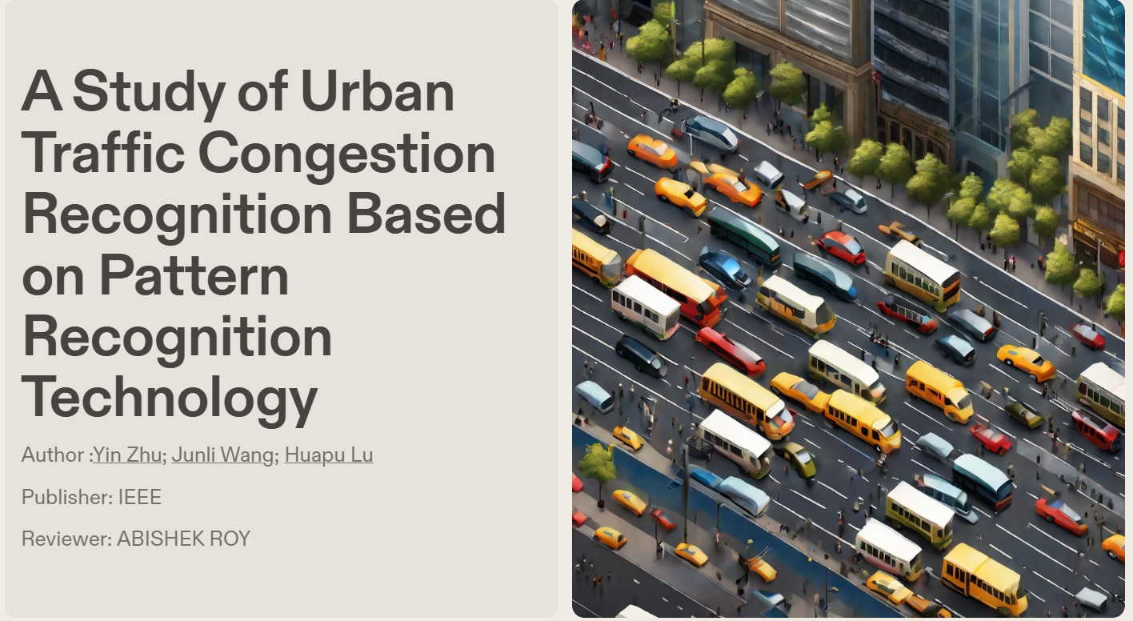

Slide 2
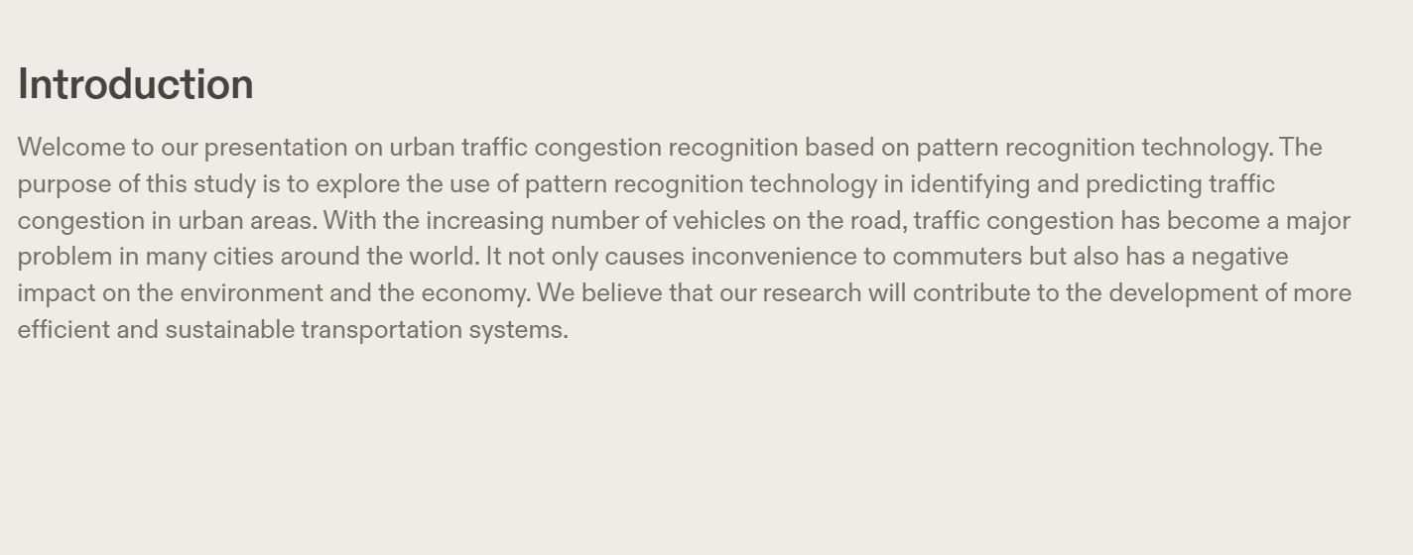

Slide 3
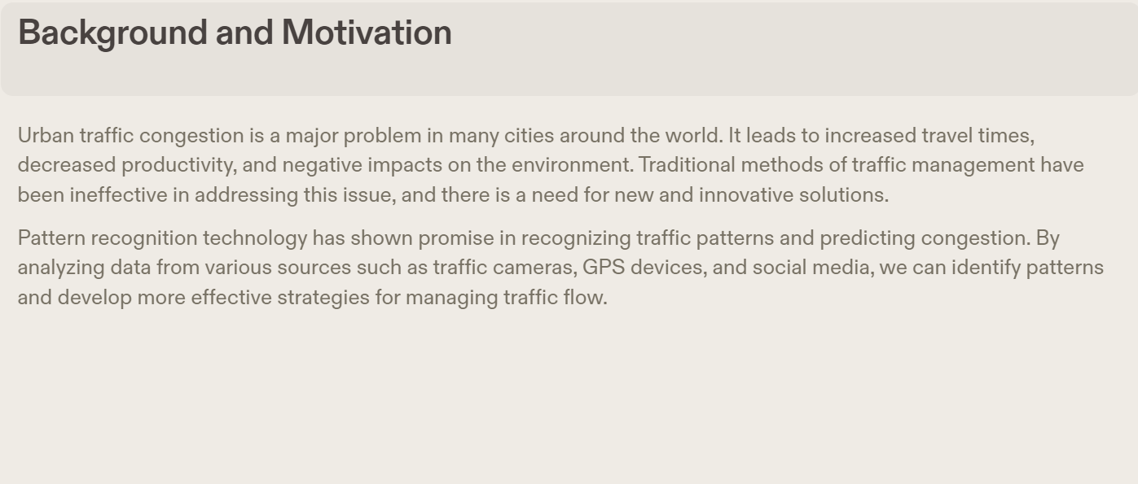

Slide 4
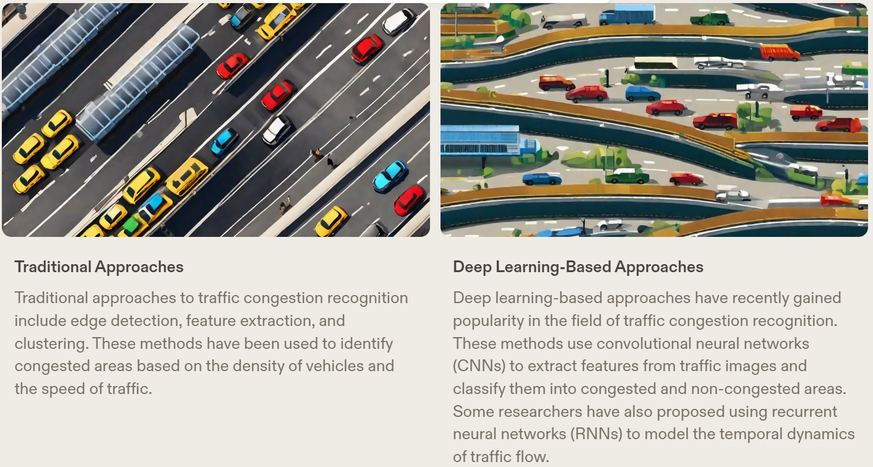
Related Work
Urban traffic congestion recognition is a field that has been extensively studied in recent years. Many researchers have proposed various methods to tackle this problem, ranging from traditional image processing techniques to deep learning-based approaches.

Slide 5
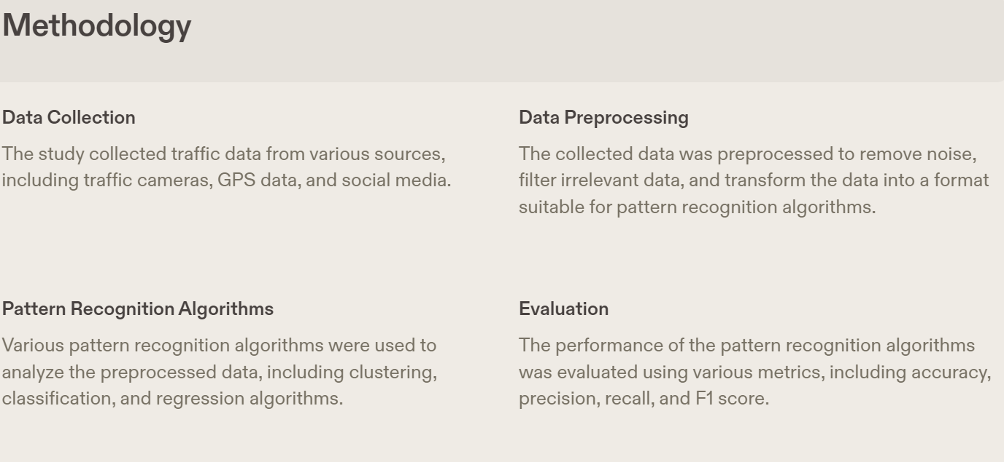

Slide 6
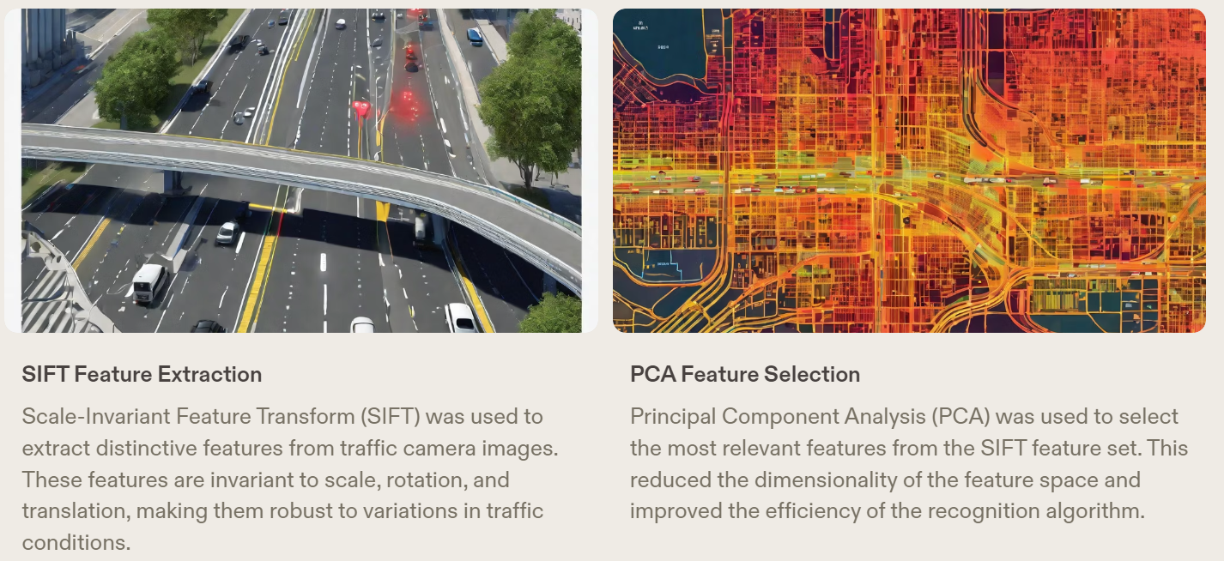
Feature Extraction and Selection
In this study, feature extraction and selection were critical steps in recognizing urban traffic congestion based on pattern recognition technology. The following methods were used:

Slide 7
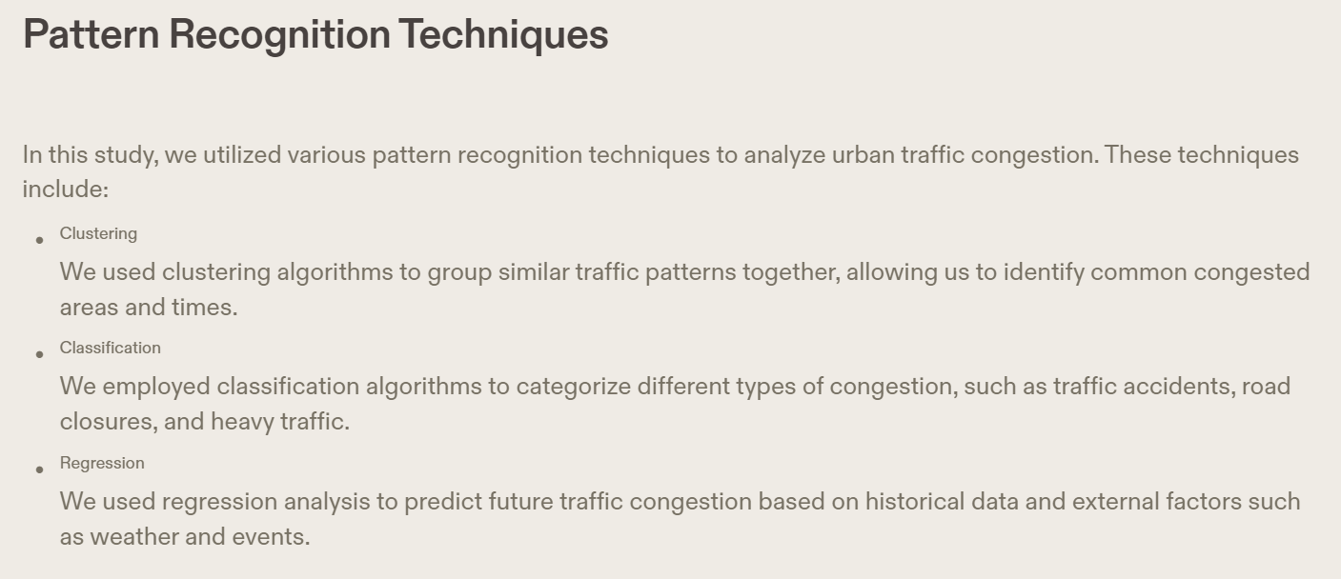

Slide 8
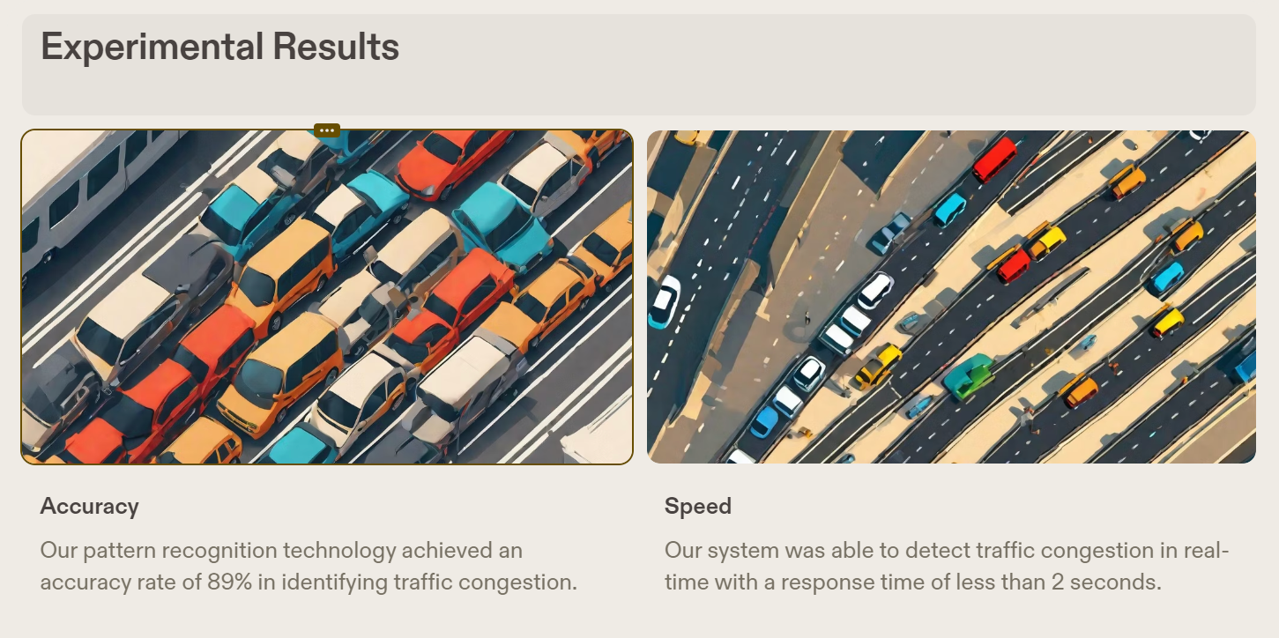

Slide 9
